Slide 1


Shokoufeh Mohammadi
…-..-2023
GitHub : shokoufeh1992/capstone

Slide 2
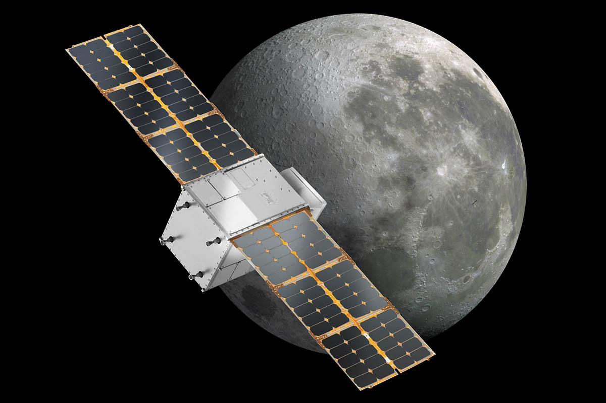
Outline
Executive Summary
Introduction
Methodology
Results
Conclusion
Appendix

Slide 3

Executive Summary
Summary of methodologies
Data collection
Data wrangling
EDA with data visualization
EDA with SQL
Building an interactive map with Folium
Building a Dashboard with Plotly Dash
• Predictive analysis (Classification)
Summary of all results
EDA results
Interactive analytics
Predictive analysis

Slide 4
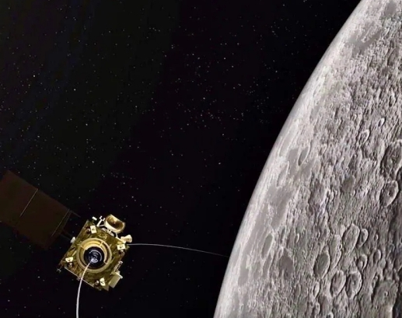
Introduction
Project background and context
SpaceX advertises Falcon 9 rocket launches on its website, with a cost of 62 million dollars; other providers cost upward of 165 million dollars each, much of the savings is because SpaceX can reuse the first stage.
Problems you want to find answers
The project task is to predicting if the first stage of the SpaceX Falcon 9 rocket will land successfully.

Slide 5

Section 1

Slide 6
Methodology
Executive Summary
Data collection methodology:
SpaceX Rest API
Web Scrapping from Wikipedia
Perform data wrangling
One Hot Encoding data fields for Machine Learning and data cleaning of null values and irrelevant columns
Perform exploratory data analysis (EDA) using visualization and SQL
Perform interactive visual analytics using Folium and Plotly Dash
Perform predictive analysis using classification models
LR, KNN, SVM, DT models have been built and evaluated for the best classifier

Slide 7
Data Collection
SpaceX launch data that is gathered from the SpaceX REST API.
This API will give us data about launches, including information about the rocket used, payload delivered, launch specifications, landing specifications, and landing outcome.
The SpaceX REST API endpoints, or URL, starts with api.spacexdata.com/v4/.
Another popular data source for obtaining Falcon 9 Launch data is web scraping Wikipedia using Beautiful Soup.
Use SpaceX Rest API
Returns SpaceX data in Json
Normalize data into csv file
Ready for data consolidation &wrangling
Get HTML Response from Wikipedia
Extract data using beautiful soup
Normalize data into csv file

Slide 8
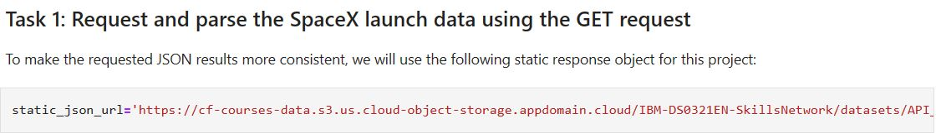
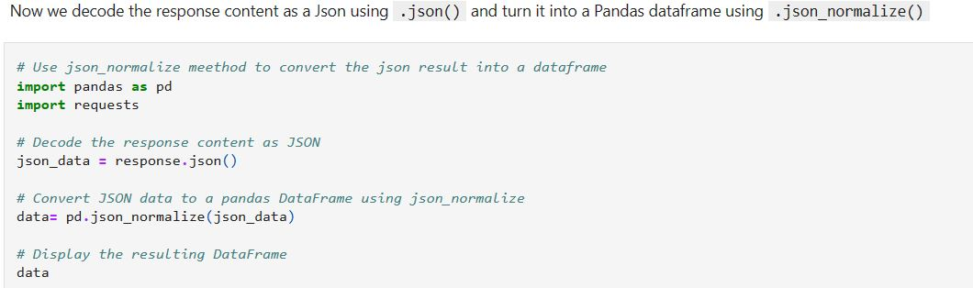
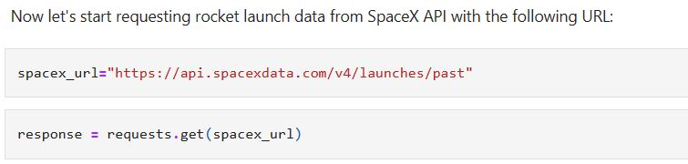
Data Collection – SpaceX API
Data collection with SpaceX REST calls
Place your flowchart of SpaceX API calls here

Slide 9
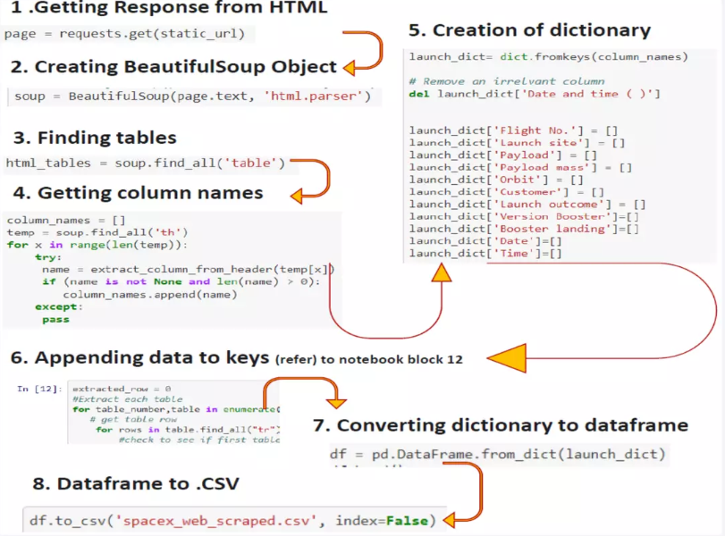
Data Collection - Scraping
Place your flowchart of web scraping here
Web Scraping from Wikipedia

Slide 10
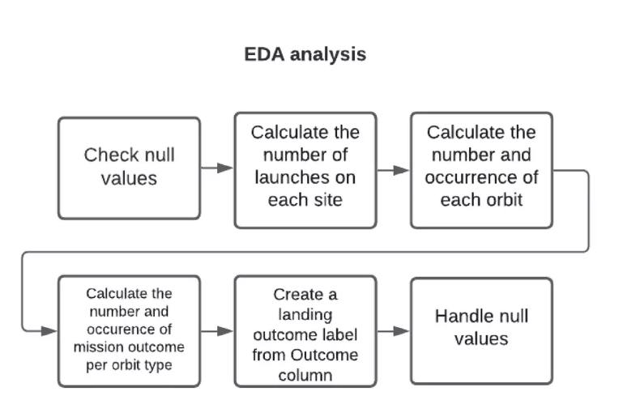
Data Wrangling

Slide 11
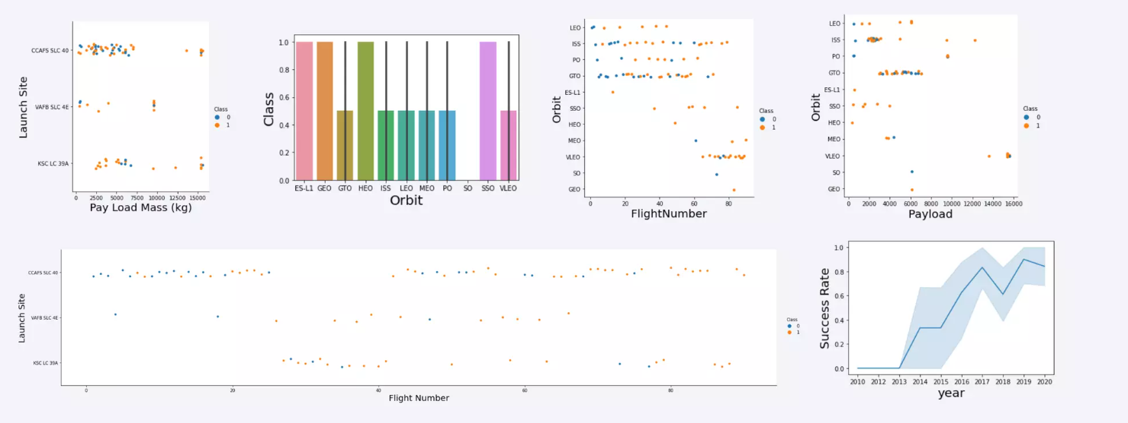
EDA with Data Visualization

Slide 12
EDA with SQL
Displaying the names of the unique launch sites in the space mission
Displaying 5 records where launch sites begin with the string 'KSC
Displaying the total payload mass carried by boosters launched by NASA (CRS)
Displaying average payload mass carried by booster version F9 v1.1
Listing the date where the successful landing outcome in drone ship was achieved.
Listing the names of the boosters which have success in ground pad and have payload mass greater than 4000 but less than 6000
Listing the total number of successful and failure mission outcomes
Listing the names of the booster versions which have carried the maximum payload mass
Listing the records which will display the month names, successful landing outcomes in ground pad booster versions, launch site for the months in year 2017
Ranking the count of successful landing outcomes between the date 2010 06 04 and 2017 03 20 in descending order.

Slide 13
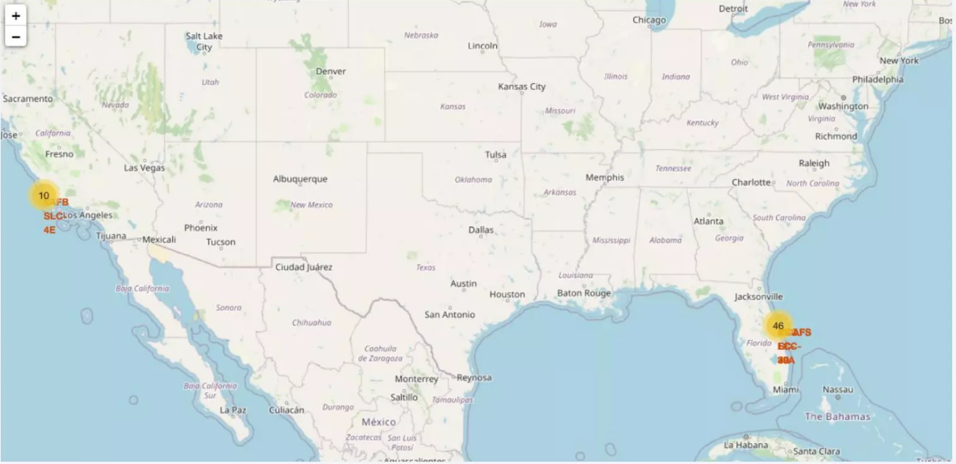
Build an Interactive Map with Folium

Slide 14
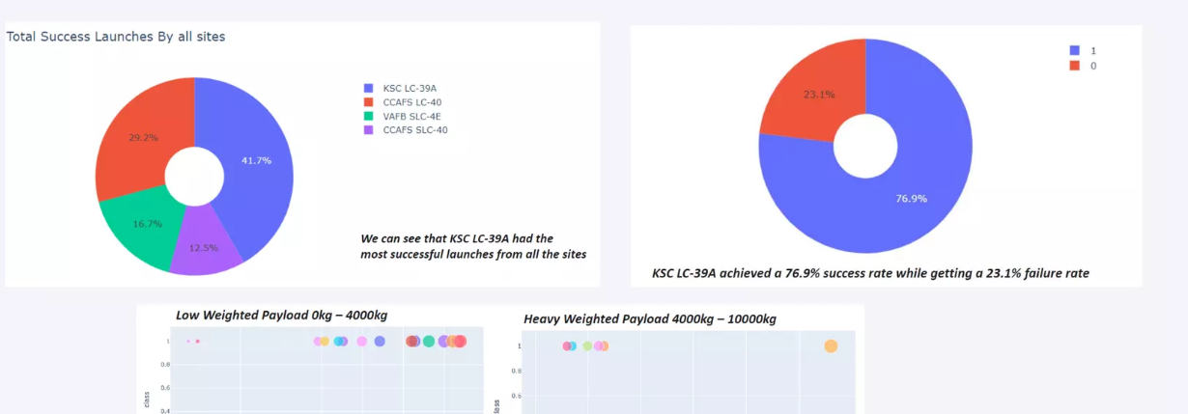
Dashboard with Plotly Dash

Slide 15
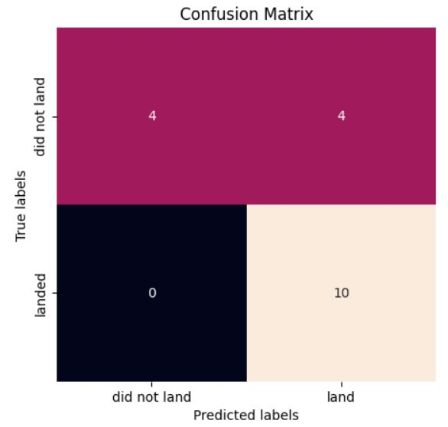

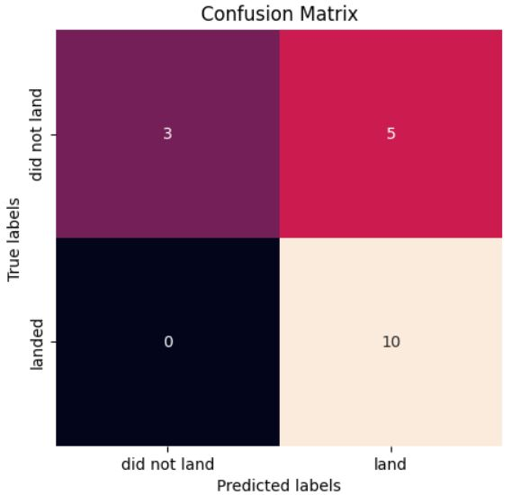
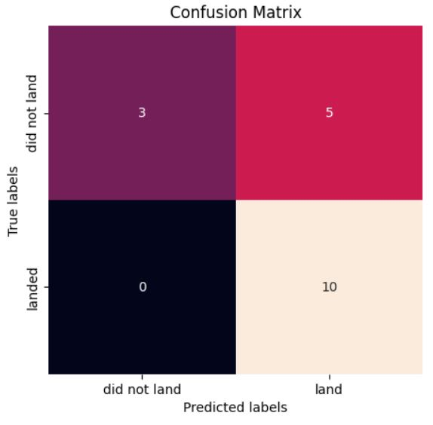
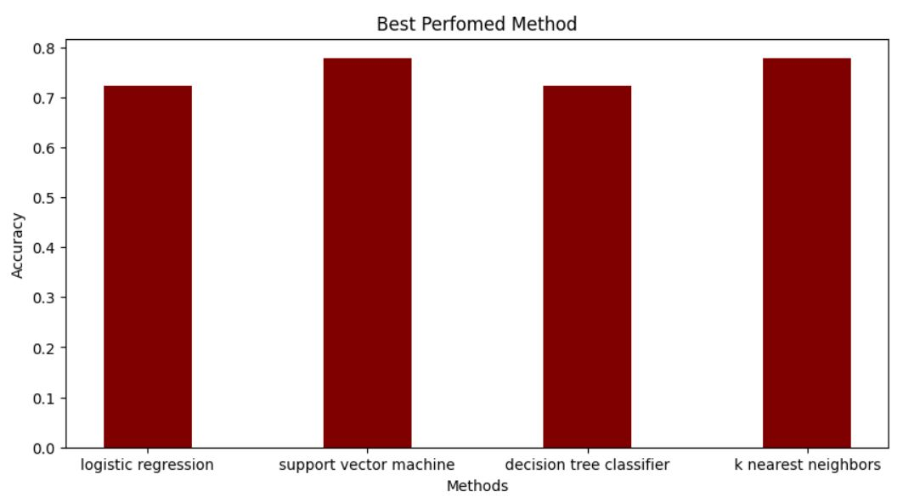
Predictive Analysis (Classification)
The SVM, KNN, and Logistic Regression model achieved the highest accuracy at 83.3%, while the SVM performs the best in terms of Area Under the Curve at 0.958.

Slide 16
Results
The SVM, KNN, and Logistic Regression models are the best in terms of prediction accuracy for this dataset.
• Low weighted payloads perform better than the heavier payloads.
The success rates for SpaceX launches is directly proportional time in years they will eventually perfect the launches.
KSC LC 39A had the most successful launches from all the sites.
• Orbit GEO,HEO,SSO,ES L1 has the best Success Rate.

Slide 17

Section 2

Slide 18
Flight Number vs. Launch Site
Show a scatter plot of Flight Number vs. Launch Site
Show the screenshot of the scatter plot with explanations

Slide 19
Payload vs. Launch Site
Show a scatter plot of Payload vs. Launch Site
Show the screenshot of the scatter plot with explanations

Slide 20
Success Rate vs. Orbit Type
Show a bar chart for the success rate of each orbit type
Show the screenshot of the scatter plot with explanations

Slide 21
Flight Number vs. Orbit Type
Show a scatter point of Flight number vs. Orbit type
Show the screenshot of the scatter plot with explanations

Slide 22
Payload vs. Orbit Type
Show a scatter point of payload vs. orbit type
Show the screenshot of the scatter plot with explanations

Slide 23
Launch Success Yearly Trend
Show a line chart of yearly average success rate
Show the screenshot of the scatter plot with explanations

Slide 24
All Launch Site Names
Find the names of the unique launch sites
Present your query result with a short explanation here

Slide 25
Launch Site Names Begin with 'CCA'
Find 5 records where launch sites begin with `CCA`
Present your query result with a short explanation here

Slide 26
Total Payload Mass
Calculate the total payload carried by boosters from NASA
Present your query result with a short explanation here

Slide 27
Average Payload Mass by F9 v1.1
Calculate the average payload mass carried by booster version F9 v1.1
Present your query result with a short explanation here

Slide 28
First Successful Ground Landing Date
Find the dates of the first successful landing outcome on ground pad
Present your query result with a short explanation here

Slide 29
Successful Drone Ship Landing with Payload between 4000 and 6000
List the names of boosters which have successfully landed on drone ship and had payload mass greater than 4000 but less than 6000
Present your query result with a short explanation here

Slide 30
Total Number of Successful and Failure Mission Outcomes
Calculate the total number of successful and failure mission outcomes
Present your query result with a short explanation here

Slide 31
Boosters Carried Maximum Payload
List the names of the booster which have carried the maximum payload mass
Present your query result with a short explanation here

Slide 32
2015 Launch Records
List the failed landing_outcomes in drone ship, their booster versions, and launch site names for in year 2015
Present your query result with a short explanation here

Slide 33
Rank Landing Outcomes Between 2010-06-04 and 2017-03-20
Rank the count of landing outcomes (such as Failure (drone ship) or Success (ground pad)) between the date 2010-06-04 and 2017-03-20, in descending order
Present your query result with a short explanation here

Slide 34

Section 3

Slide 35
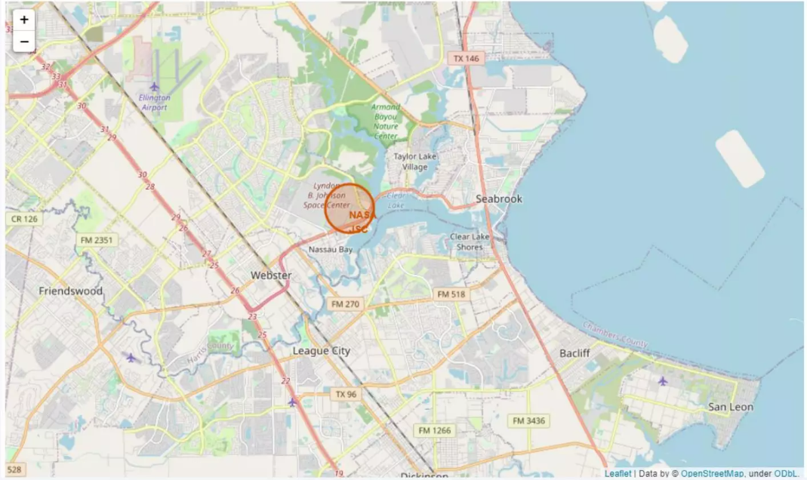
Folium Map Screenshot 1

Slide 36
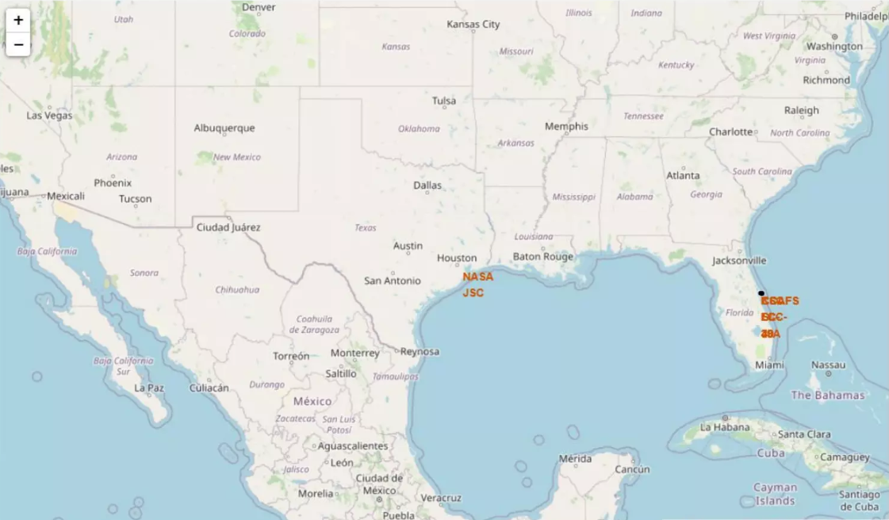
Folium Map Screenshot 2

Slide 37
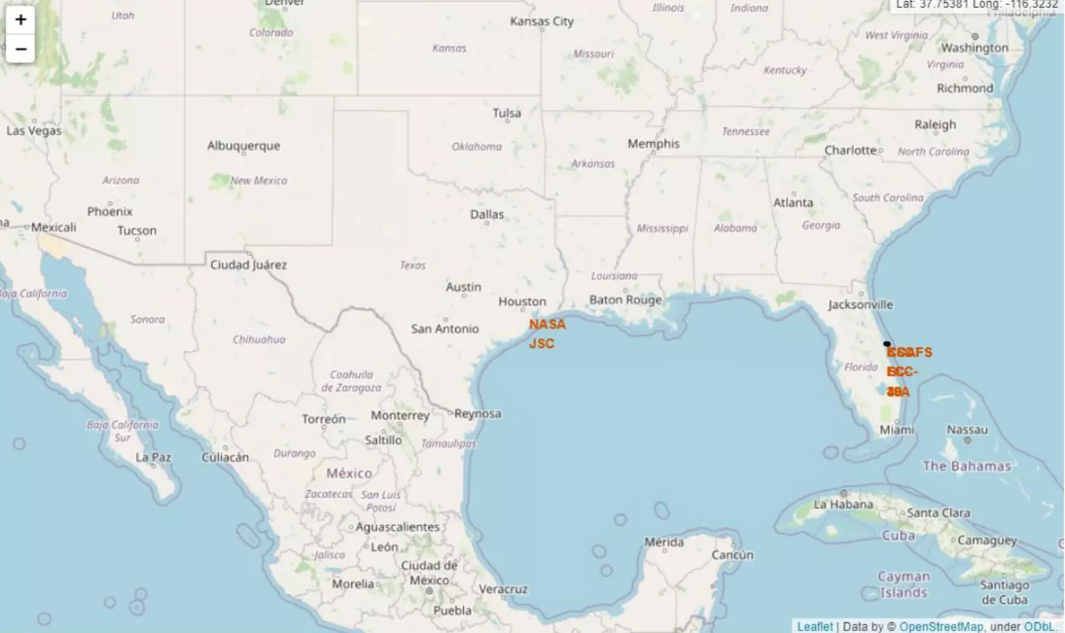
Folium Map Screenshot 3

Slide 38

Section 4

Slide 39
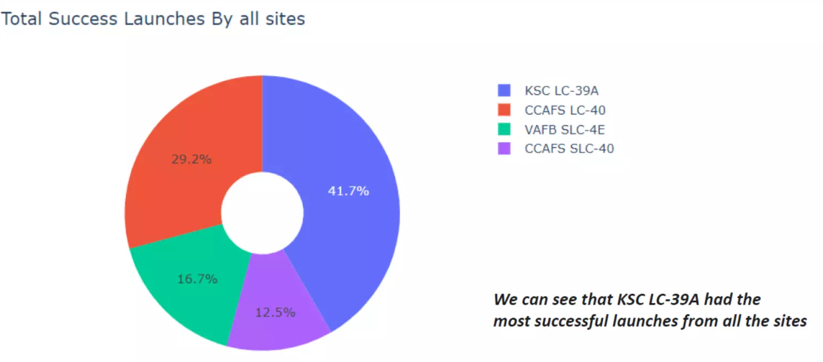
Dashboard Screenshot 1

Slide 40
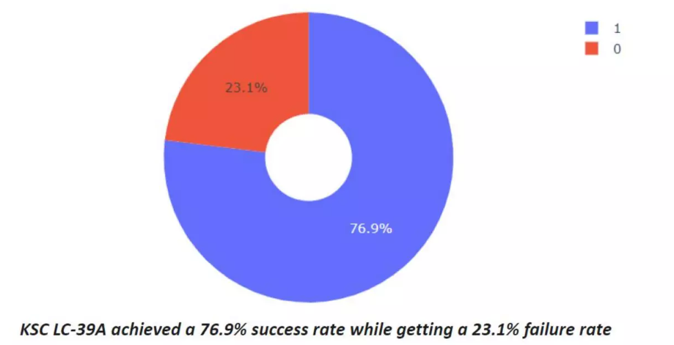
Dashboard Screenshot 2

Slide 41
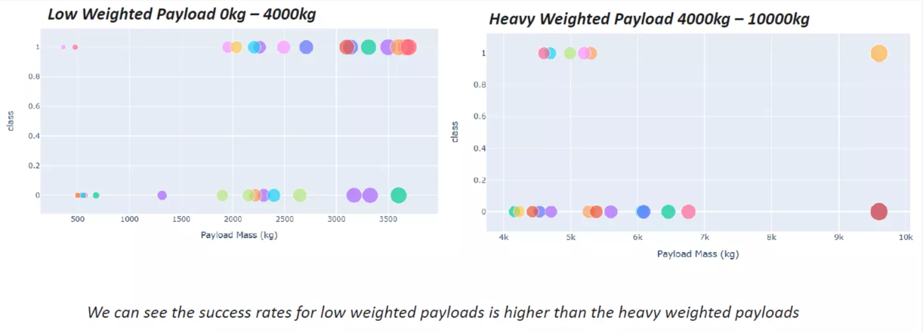
Dashboard Screenshot 3

Slide 42

Section 5

Slide 43
Classification Accuracy

Slide 44
Confusion Matrix

Slide 45
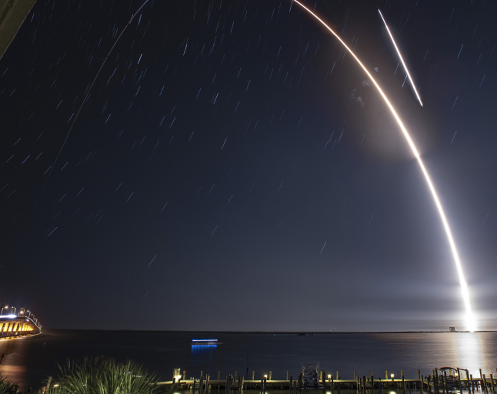
Conclusions
The SVM, KNN, and Logistic Regression models are the best in terms of prediction accuracy for this dataset.
Low weighted payloads perform better than the heavier payloads.
The success rates for SpaceX launches is directly proportional time in years they will eventually perfect the launches.
KSC LC 39A had the most successful launches from all the sites.
Orbit GEO,HEO,SSO,ES L1 has the best Success Rate.

Slide 46


